Slide 1
Final Project -3 Analyzing the Impact of Car Features on Price and Profitability
Submitted By- Anusha Gaira
anushagaira@gmail.com

Slide 2
Content
Project Description
Approach
Tech-Stack Used
Insight
Result

Slide 3
Project Description
TH
This project deal with the car industry and its featutres that will impact the price and profitability of car in future. The automated industry has been evolving over the past few decade with the growing fuel efficiency and technologies. Nowadays electric and hybrid vehicle are gaining focus in market, with the various variety it is become important to understand the factor that affecting the deamand of cars. By using the data analysis technique like regression analysis and market segmentation, the manufacturer could develop a strategy that balance demand with profitability.
We have given a dataset to gain insight into various aspect of automotive industry. By analyzing the data we can identify how price changed over years, popularity of car ,their engine power and cylinder etc.
With the help of these dataset and task analysis ,we can solve the business problem in future that will require the data analysis technique such as regression analysis, pivot tables and optimization.

Slide 4
Approach
Understanding
Download the dataset in excel and getting through the data to understand the features and its impact.
Data Cleaning
Remove all the duplicate rows and find the blank and replace with average.
Data Analysis
After Cleaning the Data, analyze the data and drew the insight and conclusion for given tasks.
Data Visualization
After Analyzing the data visualize it in chart and draw the dashboard.

Slide 5
Tech-stack Used
Microsoft Excel 2016 Microsoft Power Point
Data Cleaning PPT
Data Analysis
Visualization
Dashboard

Slide 6
DataSet Used
The variables in the dataset are:
Make: the make or brand of the car
Model: the specific model of the car
Year: the year the car was released
Engine Fuel Type: the type of fuel used by the car (gasoline, diesel, etc.)
Engine HP: the horsepower of the car's engine
Engine Cylinders: the number of cylinders in the car's engine
Transmission Type: the type of transmission (automatic or manual)
Driven Wheels: the type of wheels driven by the car (front, rear, all)
Number of Doors: the number of doors the car has
Market Category: the market category the car belongs to (Luxury, Performance, etc.)
Vehicle Size: the size of the car
Vehicle Style: the style of the car (Sedan, Coupe, etc.)
Highway MPG: the estimated miles per gallon the car gets on the highway
City MPG: the estimated miles per gallon the car gets in the city
Popularity: a ranking of the popularity of the car (based on the number of times it has been viewed on Edmunds.com)
MSRP: the manufacturer's suggested retail price of the car

Slide 7
INSIGHTS
Task 1: The popularity of a car model across different market categories
Insight -From the given chart we find out that hatchback and flex fuel are most popular car model while luxury and exotic are least popular among cutomers.

Slide 8
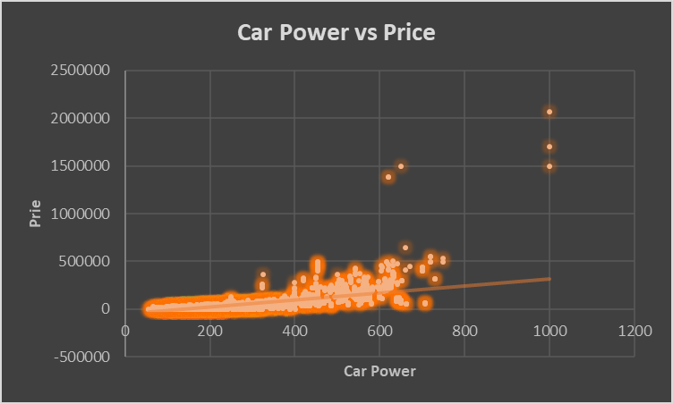
Task 2- relationship between a car's engine power and its price
Insight - By observing the Trend-line of given chart, we find out that car’s engine power and price have positive relationship. Car power increased with respect to its price.

Slide 9
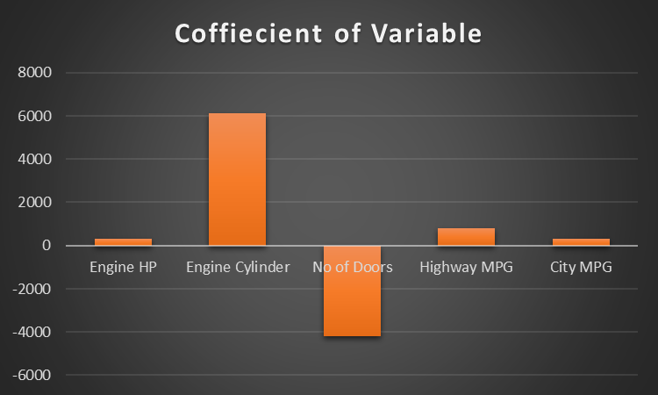
Task 3 - most important car features in determining a car's price
Insight – From the chart we find out that Engine Cylinder and Price have strong relation among all the car features while No of doors does' not matter while determining the car price.

Slide 10
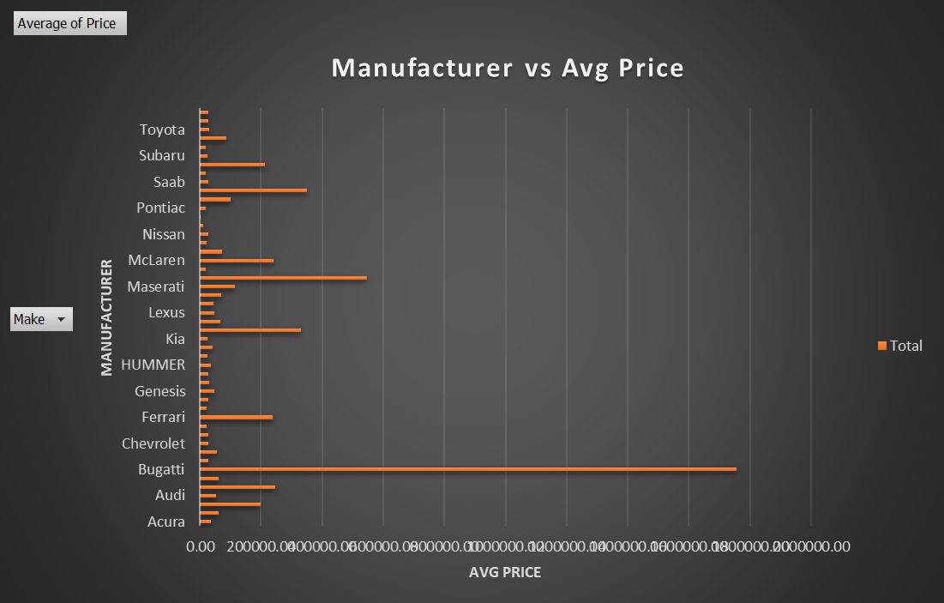
Task 4 – The average price of a car among different manufacturers
Insight – From the chart it can observed that Bugatti have the maximum average price and play mouth have least.
Manufacturer | Average of Price
Bugatti | 1757223.67
Plymouth | 3122.90

Slide 11
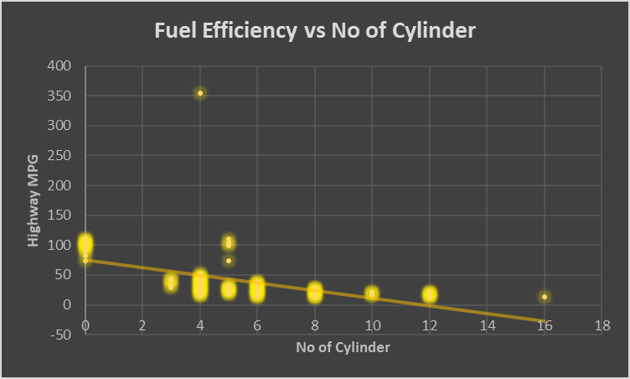
Task 5 - relationship between fuel efficiency and the number of cylinders in a car's engine
correlation | -0.5319
Insight – It is quite visible from the given trend line that no of cylinder decreases with respect to fuel efficiency. if fuel efficiency is more than no of cylinder will be less. That’s why correlation is negative between them.

Slide 12
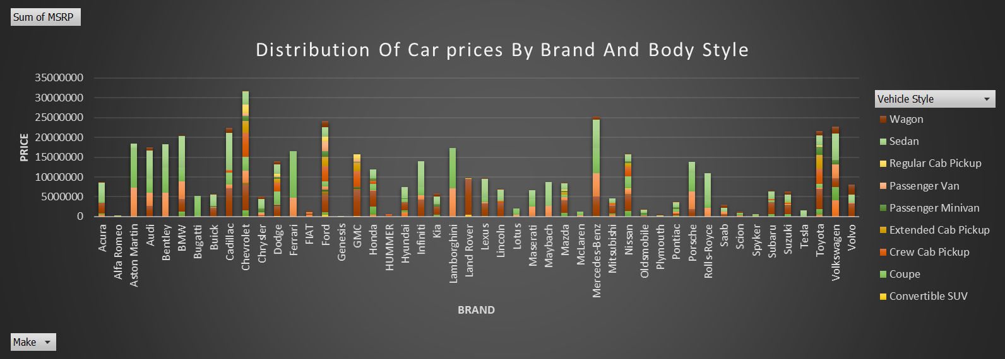
Dashboard 1- distribution of car prices vary by brand and body style
Insight-From the stacked column chart we observed that body style of Chevrolet contribute most to the highest car prices also sedan and coupe style have higher price than others.

Slide 13
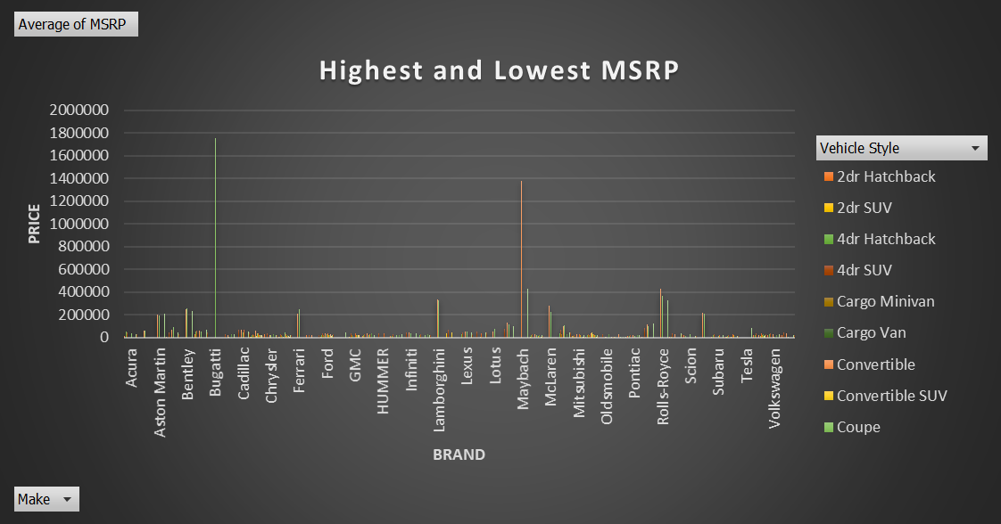
Dashboard 2 – AVERAGE MSRP OF car BY brands AND BODY STYLE
Insight - We can see From this Clustered Column chart that Coupe Style Bugatti have highest number of average MSRP.

Slide 14
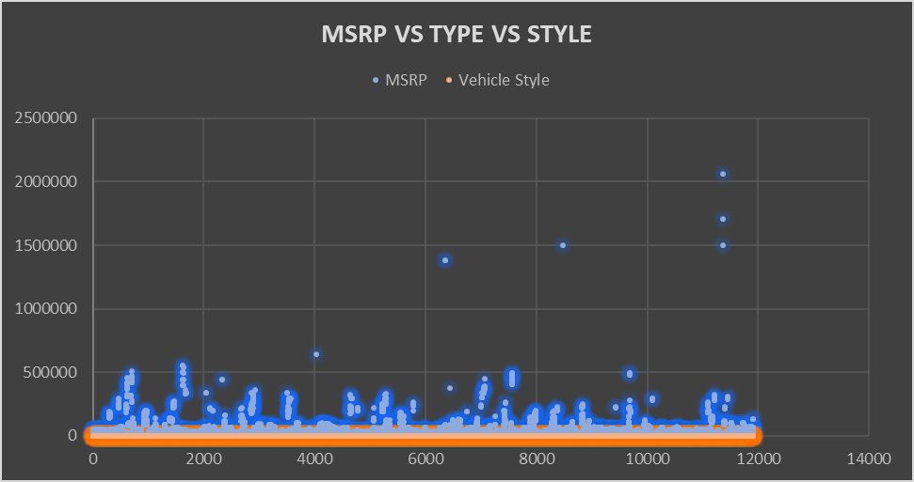
Dashboard 3 – RELATIONSHIP BETWEEN different feature AND MSRP
Insight – From this graph we observed that automated converted and automated manual coupe highly contributed to the price of car.

Slide 15
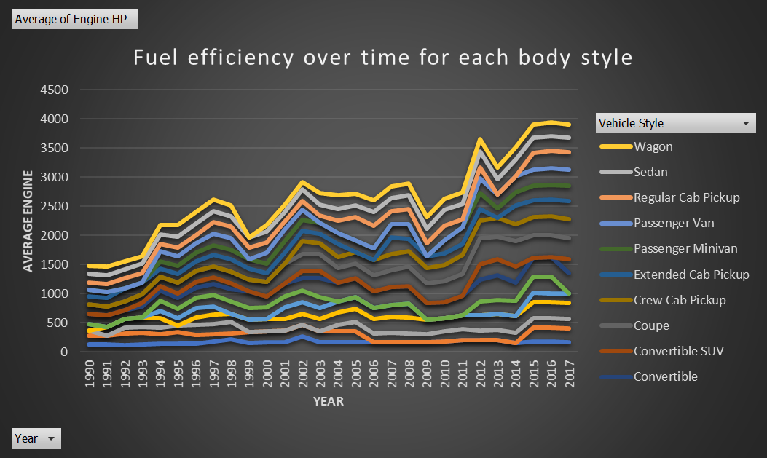
Dashboard 4-fuel efficiency of car OVER years
INSIGHT- With the help of this line chart we observed that fuel efficiency of car increased with each passing year. Wagon style’s have fuel efficiency over year.

Slide 16
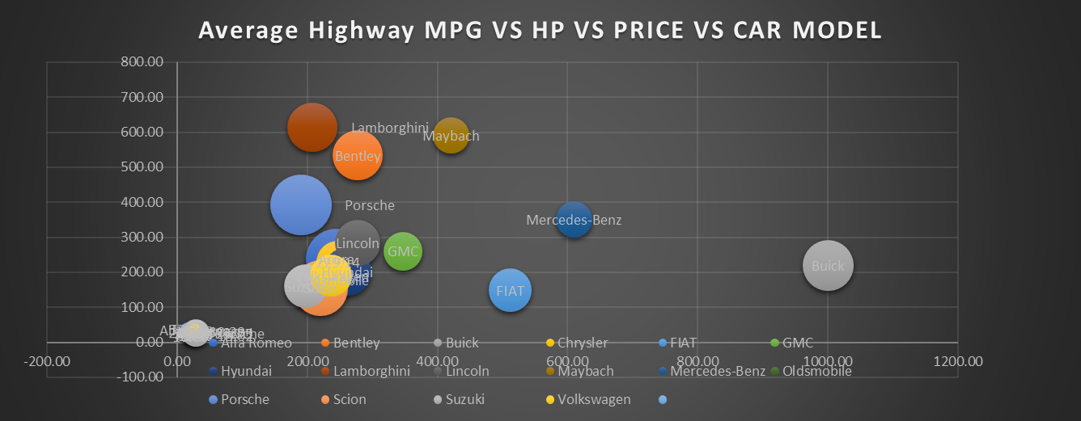
DASHBOARD 5 – Relationship between different car's horsepower vs MPG
Insight – This Bubble chart shows that car with high Engine power have high price and car with high highway mpg have less price.

Slide 17
Result
With the help of dashboard and various chart we find out that ----
Coupe Body Style have highest Contribution in price.
Hatchback and flex fuel are most popular style among customer.
Now days people prefer high fuel efficiency and automated converted and automated coupe cars.
Car engine power increase with the price and Coupe style Bugatti have maximum price.
Coupe style car are very popular among customers in terms of style, fuel and price.
Manufactures should be more focused on fuel efficiency of car and its style.
Excel Link ---Cardataset
Video Link –Car_features_video

Slide 18
THANK YOU

